Slide 1
School mapping in ESRI imagery
Andrija Gorup, Dominik Jambrović, Marin Kačan, Siniša Šegvić
December 12th, 2024

Slide 2
Recap from last meeting

Slide 3
Sampling method choice
Inverse or Gaussian sampling
Static or dynamic sampling
Dynamic or OHEM sampling
We’ve seen that static Gaussian sampling and dynamic Gaussian sampling yield the best results
Our choice: static Gaussian sampling

Slide 4
Number of epochs validation
Increased number of epochs (20 vs 13)
Measure F1-score over epochs on both train and validation set
Chosen number of epochs for fine-tuning: 20 epochs

Slide 5
Model fine-tuning
All Anditi schools + equal number of OSM Vietnam non-schools
Static Gaussian non-school sampling
20 epochs
Train results
F1: 99.55%
P: 99.80%
R: 99.30%

Slide 6
New contributions

Slide 7
Dense inference
Use fine-tuned model on overlapping satellite images (tiles) from chosen districts
Perform non-maximum suppression (NMS) to reduce the number of duplicate detections

Slide 8
Dense inference
Measure number of detected Anditi schools:
For each Anditi school, do the following:
1. find satellite images which contain the school
2. check if the model’s prediction for at least one of the neighboring satellite images is above 0.5
3. if not, memorize the nearest satellite image, as well as the distance and probability
Finally, calculate recall, as well as the total number of detected Anditi schools
Deliver list of potential schools sorted by prediction confidence

Slide 9
Dense inference results (before NMS)
Found 920 / 946 (97.25%) Anditi schools
Recall (minimum probability): 1.80%
Recall (mean probability): 47.25%
Recall (maximum probability): 97.25%
26 not detected schools (2.75%)

Slide 10
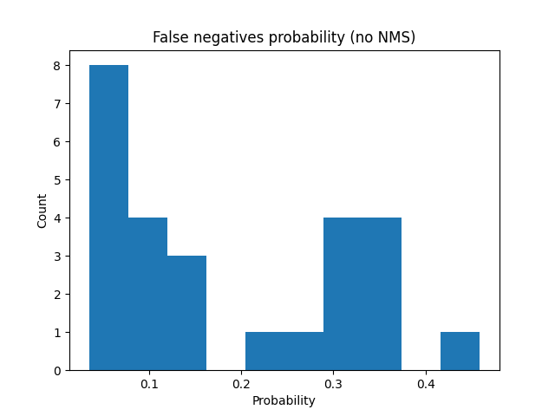
Dense inference results (before NMS)

Slide 11
Dense inference results (after NMS)
Found 900/946 (95.14%) Anditi schools
Recall (min probs): 95.14%
Recall (mean probs): 95.14%
Recall (max probs): 95.14%
46 not detected schools (4.86%)

Slide 12
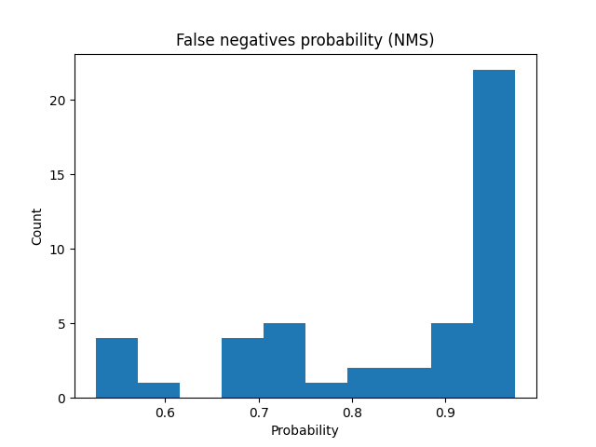
Dense inference results (before NMS)

Slide 13
List of potential schools
Satellite images classified as schools by the fine-tuned model
Images are sorted by prediction confidence – images with the highest confidence come first
Non-maximum suppression was applied to the list to avoid overlapping detections

Slide 14
List of potential schools
9573 images
Top 15 images:
4 are marked on Google Maps (manual check)
3 of those 4 images are in the Anditi dataset

Slide 15
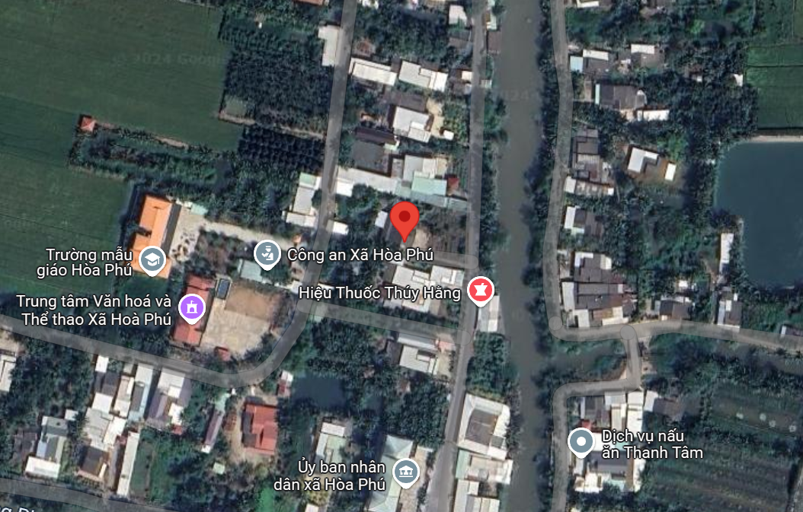
List of potential schools - examples

Slide 16
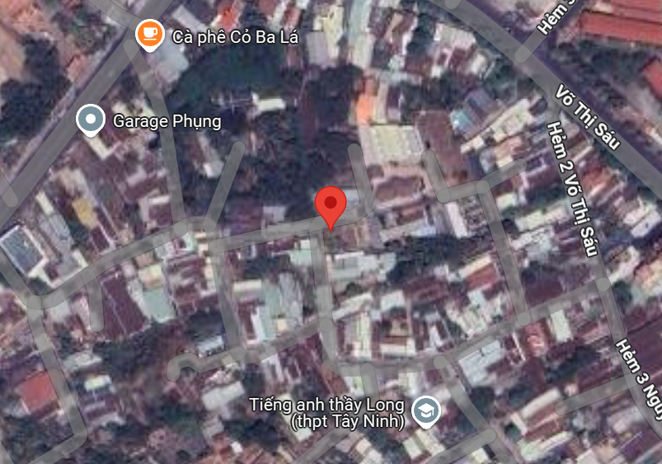
List of potential schools - examples

Slide 17
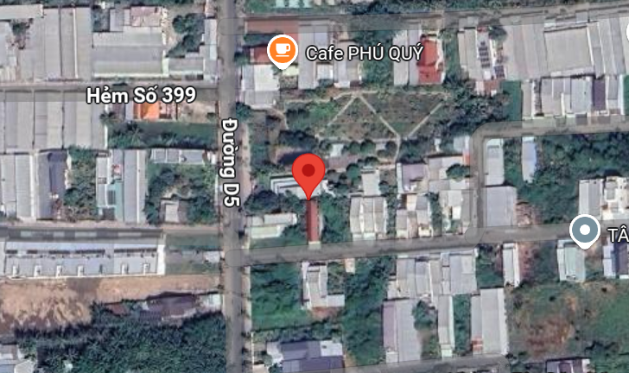
List of potential schools - examples

Slide 18
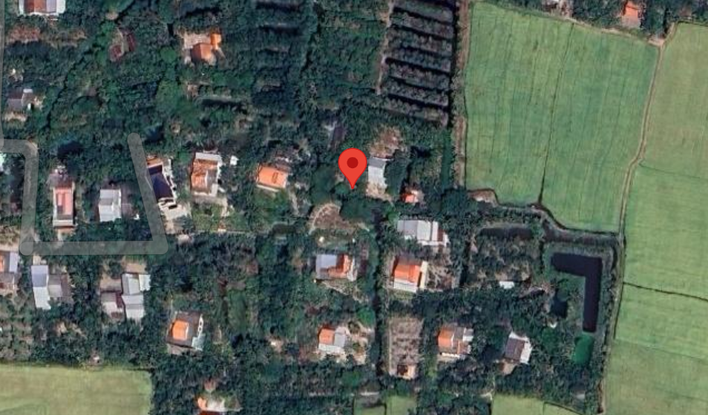
List of potential schools - examples

Slide 19
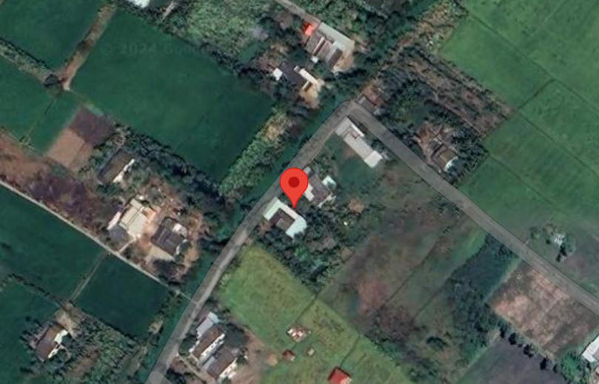
List of potential schools - examples

